Slide 1


Financial Performance Dashboard
Data Analyst Internship — Task 4 Submission
Prepared By Ankita Daweshar
Organization Elevate Labs
Date June 2026

Slide 2



OBJECTIVE & DATASET SPECIFICATIONS
Business Objective
Dataset & Tooling Details
•
Design and engineer an interactive, three-page Business Intelligence dashboard in Power BI to deliver deep, actionable financial insights to corporate leadership.
•
Explored Kaggle's verified Global Financial Sample dataset to trace enterprise operations across diverse global markets.
•
Dataset Structure: 700 rows × 16 columns (referenced as Financials.csv).
•
Empower management with real-time visual analysis of net revenue, cost variables, and profit margins.
•
Primary Tool: Power BI Desktop for data transformation, DAX modeling, KPI tracking, and interactive UX design.
•
Uncover margin performance variance across countries and segment lines.
•
Key Columns Analyzed: Segment, Country, Product, Units Sold, Gross Sales, Sales, COGS, Profit, and Dates.
•
Utilize dynamic filters to slice results by product, country, and year.

Slide 3


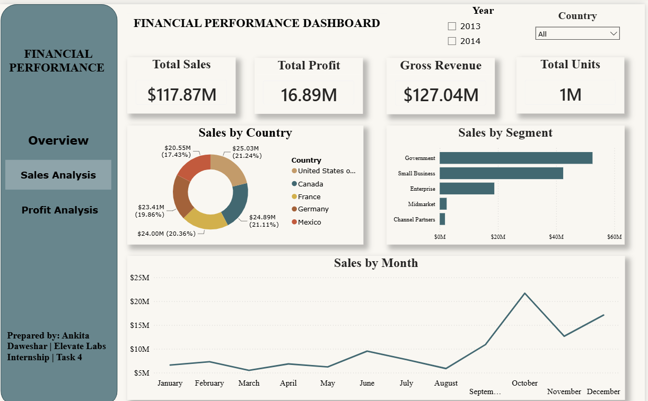


GLOBAL SALES OVERVIEW
Analysis of Page 1 (page1_sales_overview.png) highlights strong public sector demand and exceptionally healthy geographic distribution of revenue.
$117.87M
USA
TOTAL NET SALES
TOP COUNTRY ($25.03M)
Government
October
BEST SEGMENT ($52.50M)
SEASONAL SALES PEAK
→
Government Segment dominates the business, driving 44.5% of overall global revenue.
→
North American region (USA + Canada) contributes a massive $49.92M in combined sales.

Slide 4

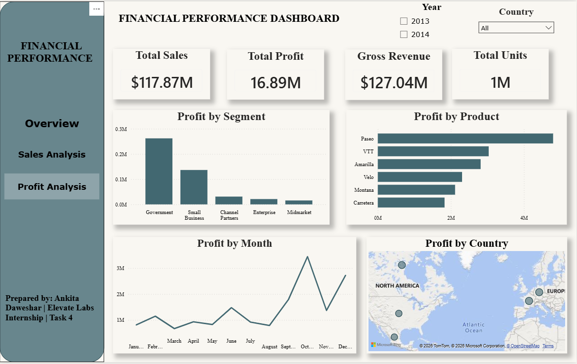
PROFITABILITY & MARGIN ANALYSIS
Analysis of Page 2 (page3_profit_analysis.png) assesses operational cost elements relative to net earnings, highlighting excellent product margins.
$16.89M
Paseo
TOTAL NET PROFIT
TOP PRODUCT ($4.80M)
$100.98M
14.3%
TOTAL COGS (COST)
PROFIT-TO-SALES RATIO
→
Government segment drives enterprise profits with $11.39M in total net gains.
→
Healthy overall margin profile, offset primarily by selective low-performing business segments.

Slide 5

EXECUTIVE STRATEGY & NEXT STEPS
Strategic Findings
Recommended Roadmap
Segment Concentration Government and Small Business capture the bulk of profit margins, while the Enterprise segment currently represents an operational drag.
Optimize Resource Allocation Direct sales and operational resources toward securing high-margin Government contracts and Small Business pipelines.
Product Leaders Paseo generates strong profit ($4.80M) while Carretera lags behind as the weakest profit contributor.
Control COGS & Pricing Audit and negotiate manufacturing/discount rates for underperforming product lines to elevate Carretera's performance.
Seasonal Volatility Year-end sales peaks in October ($20.55M) and December ($19.34M) heavily dictate annual working capital.
Targeted Marketing Campaigns Build proactive promotional and distribution strategy ahead of the Q4 spike (October and December).

